Slide 1
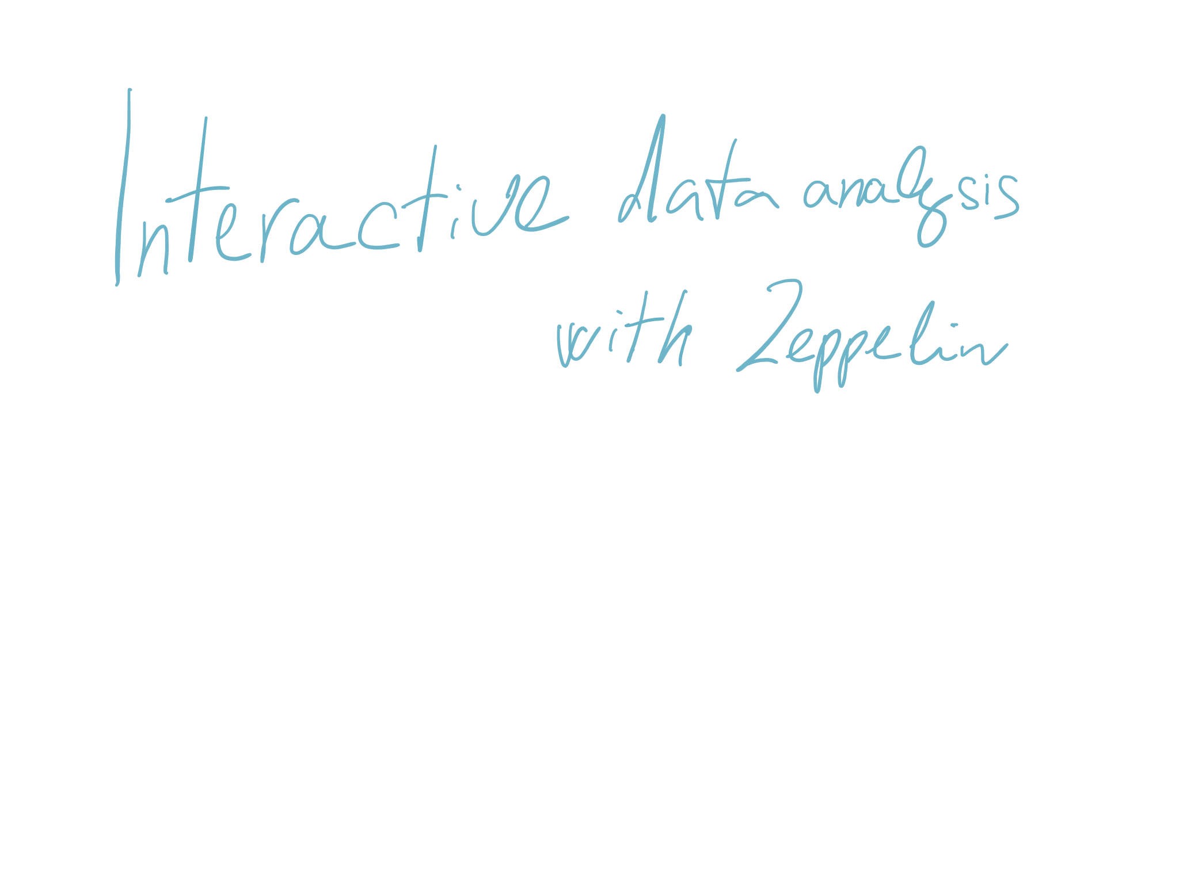


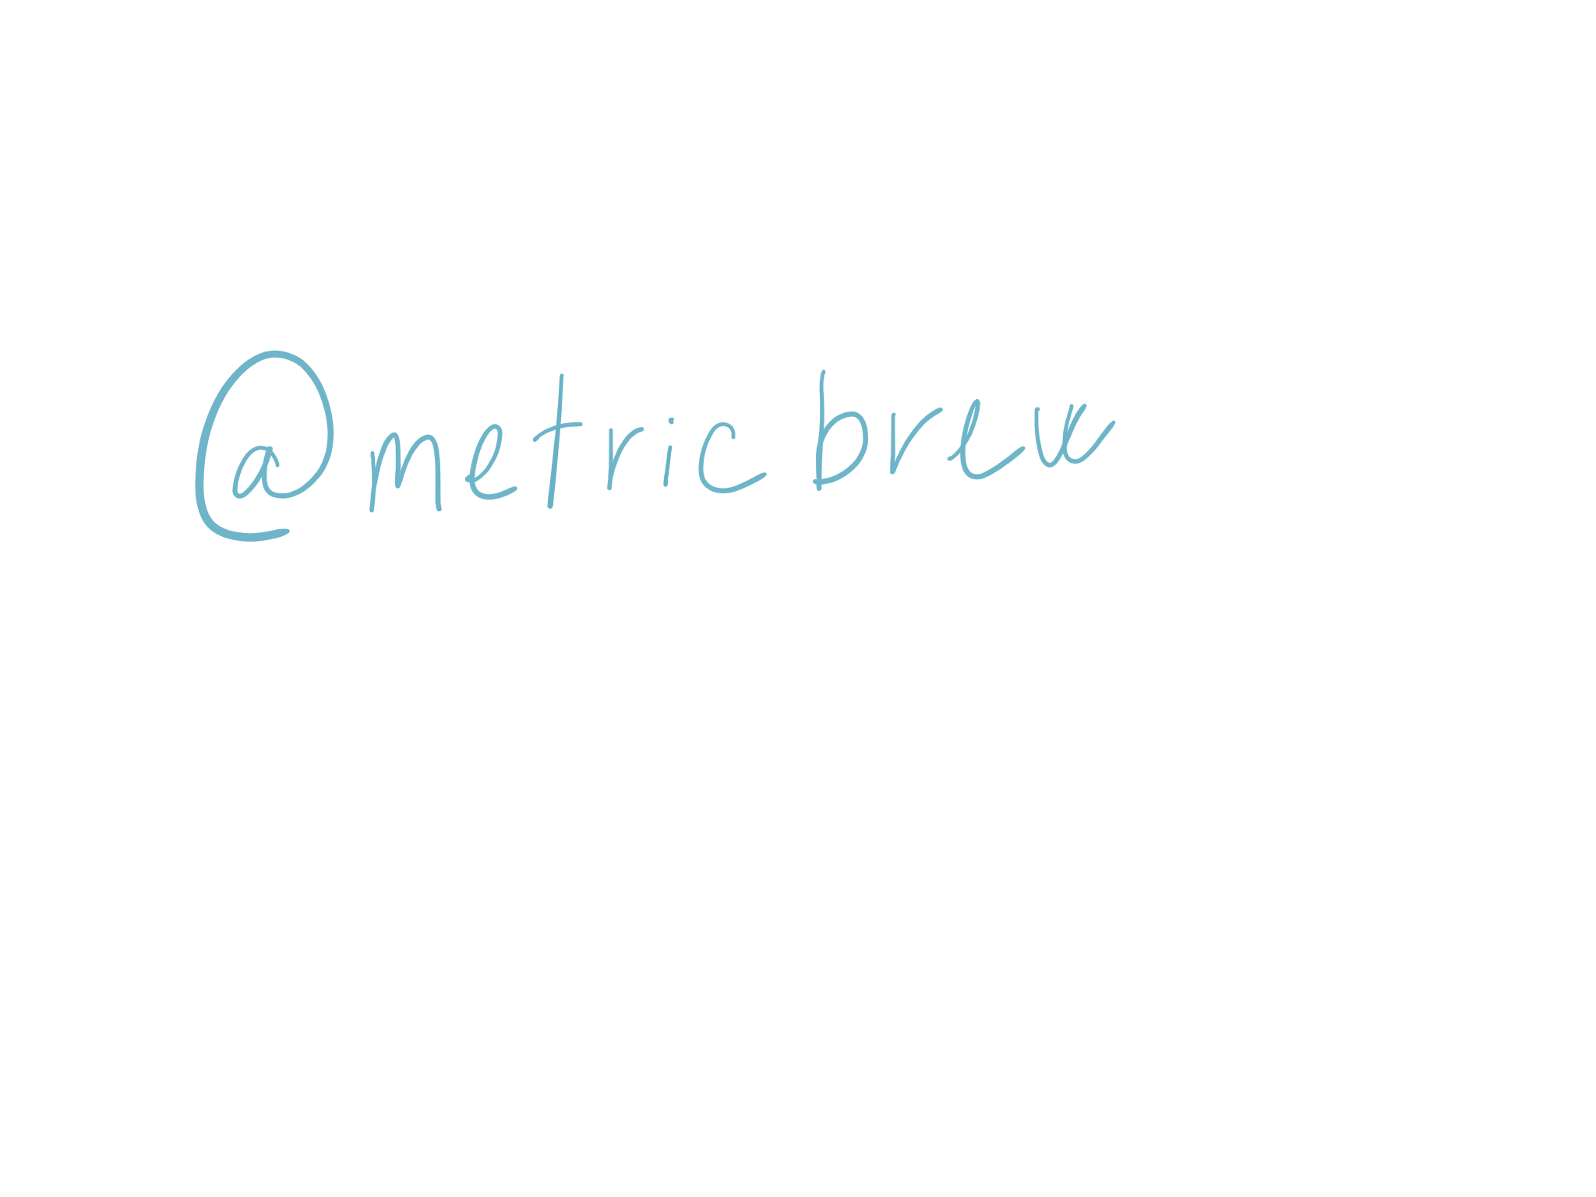

Slide 2

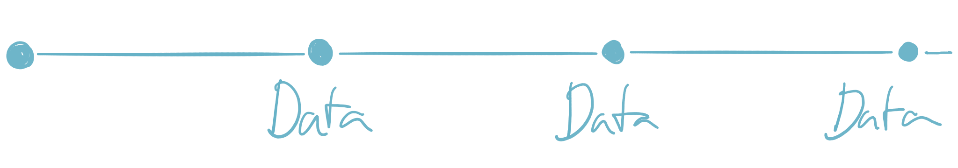
Who am I

Slide 3




Slide 4

@metricbrew
Notes:
Data scientists and companies have their own tools

Slide 5

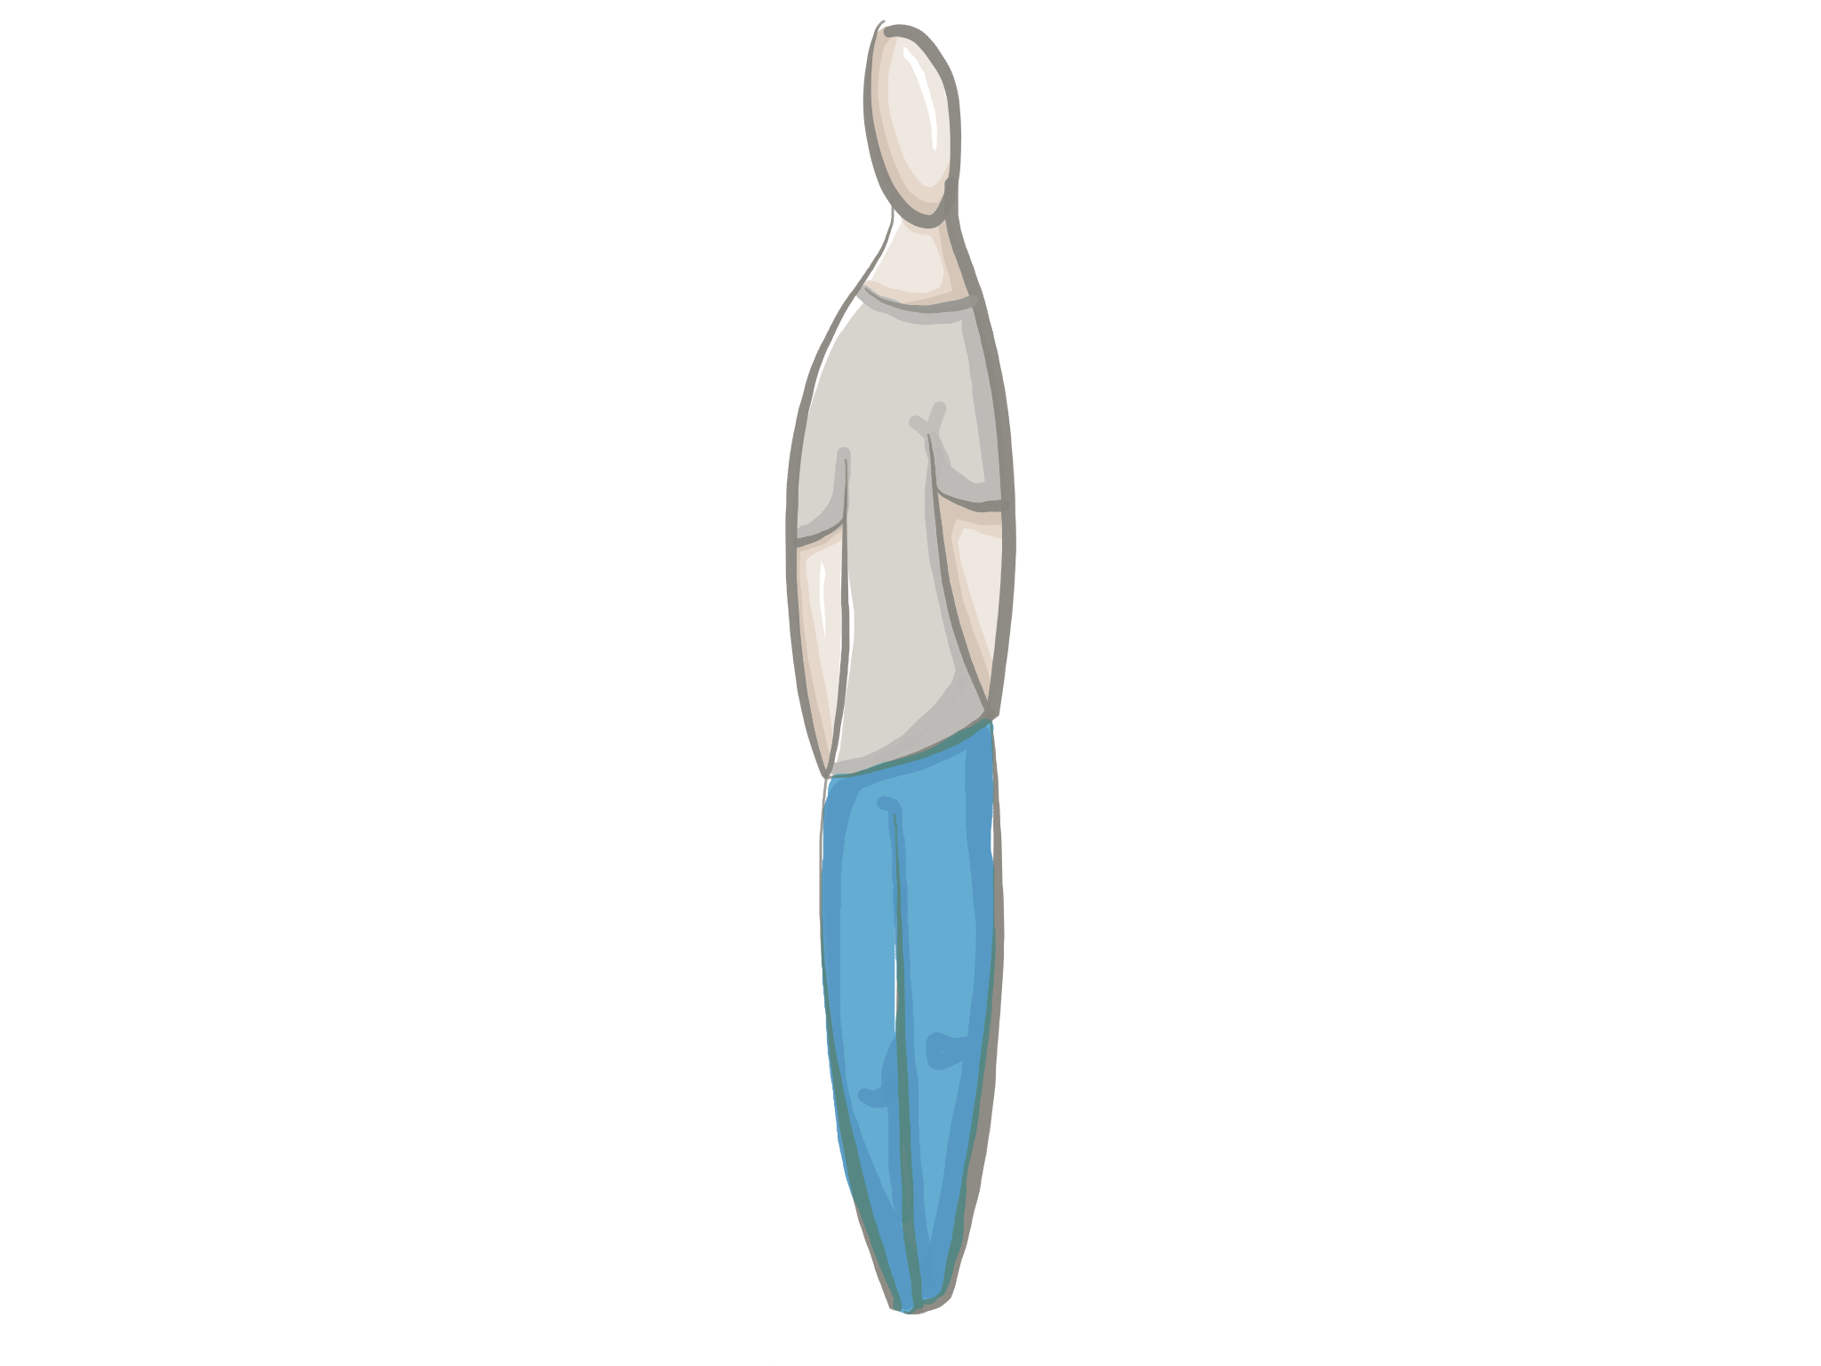
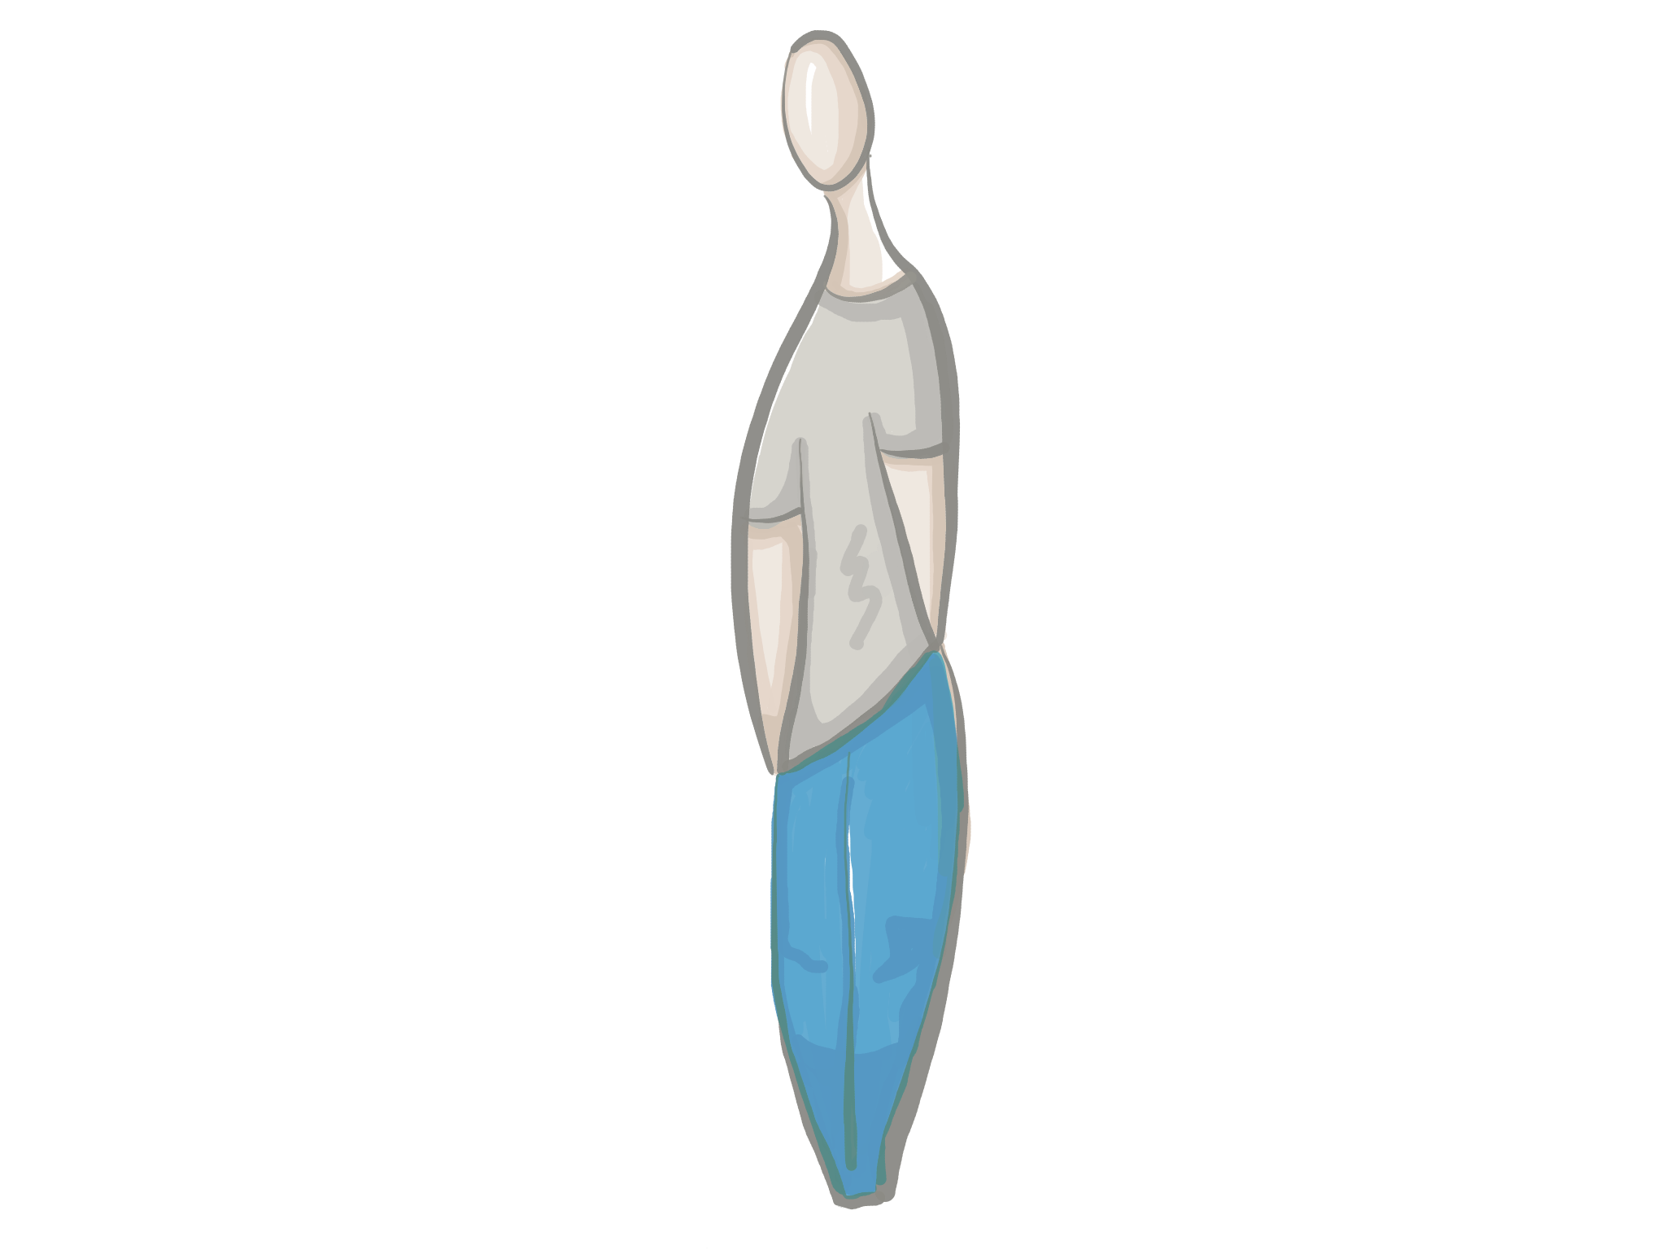
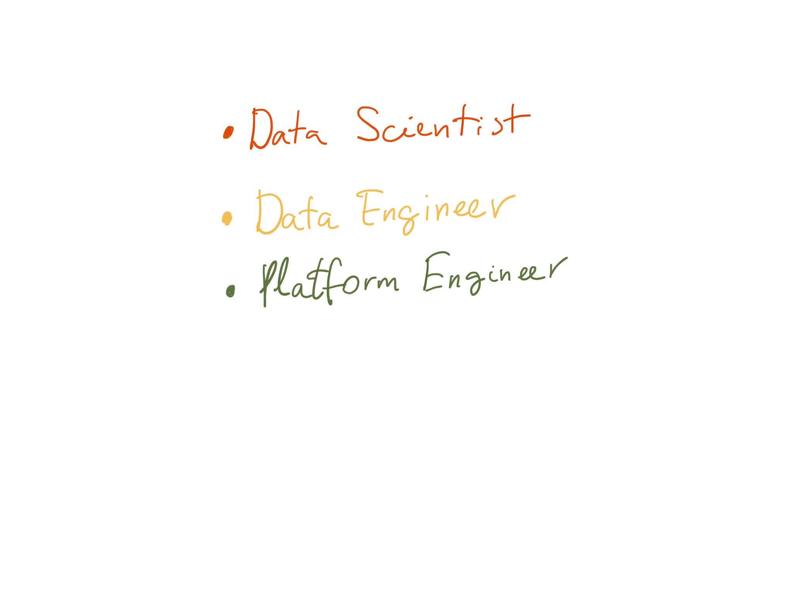
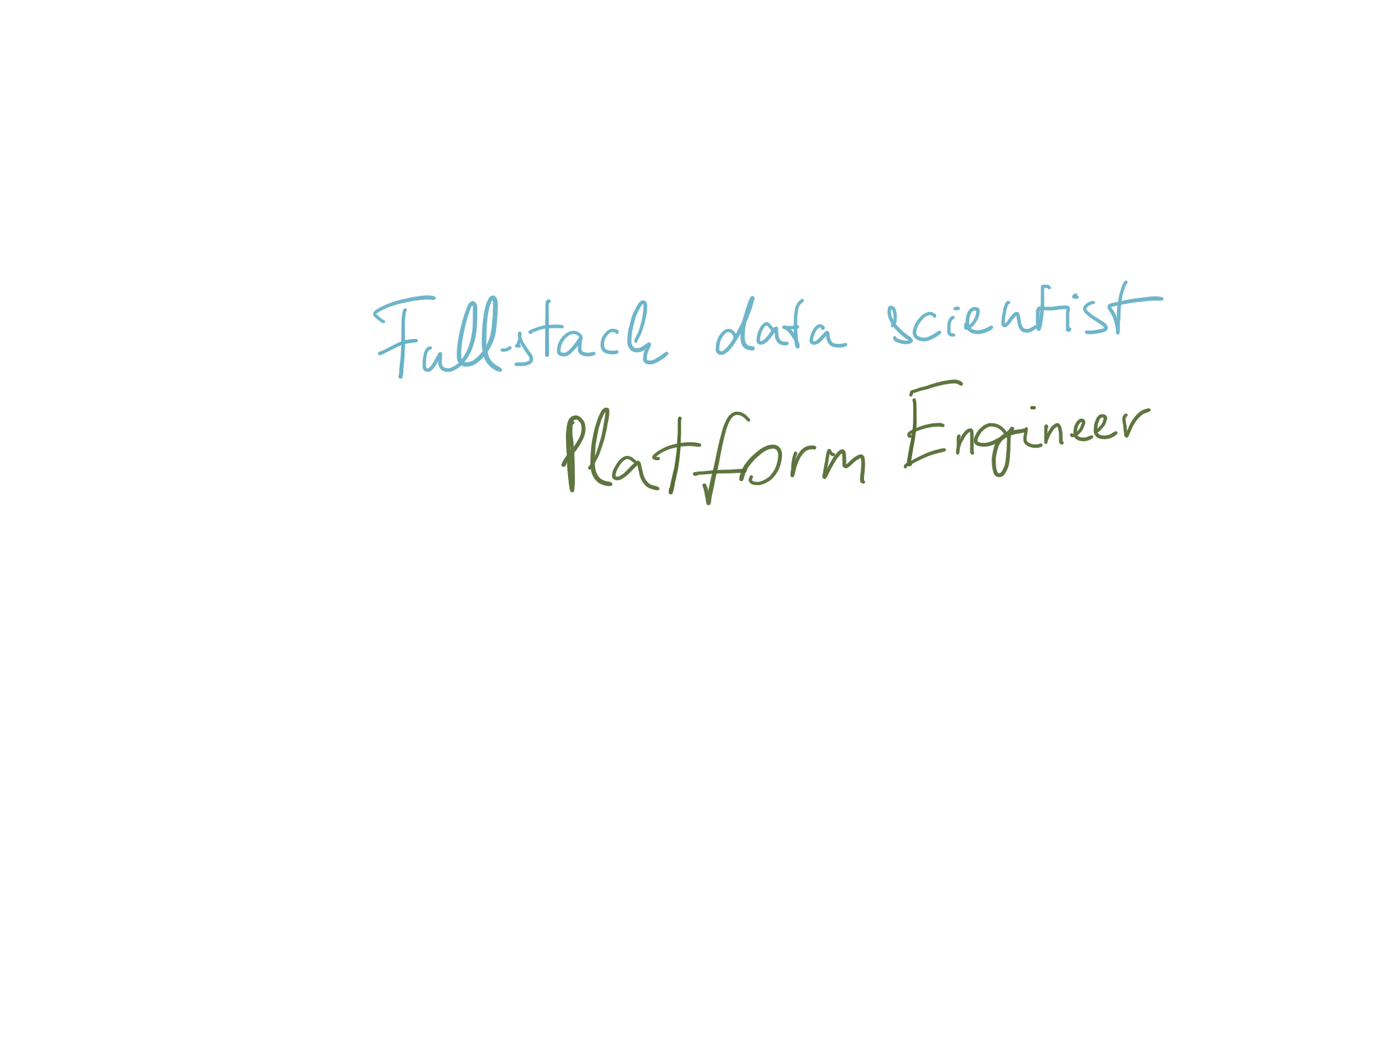
Data Science teams
@metricbrew

Slide 6






Data Scientists
The Polyglot term borrowed from Jeroen Janssens
@metricbrew

Slide 7


Reports vs. data science
@metricbrew
Notes:
Report development involves doers – specs
Data science is about thinkers - insights
Scripts and IDEs vs interpreters

Slide 8
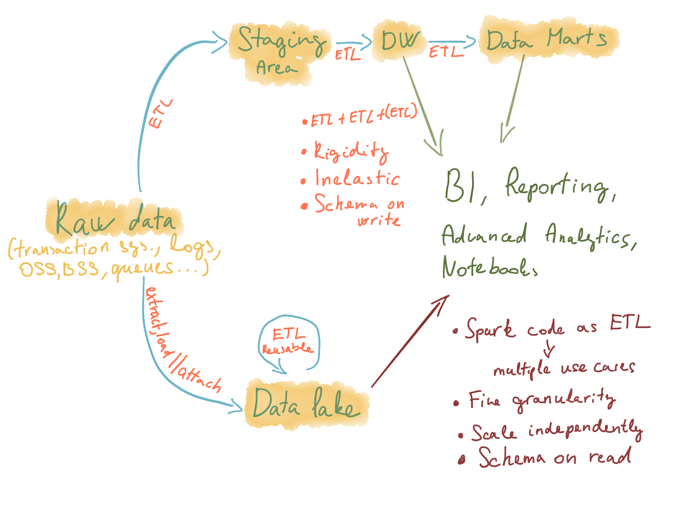
Journey of data
@metricbrew

Slide 9

Data Scientist’s toolbox
@metricbrew

Slide 10

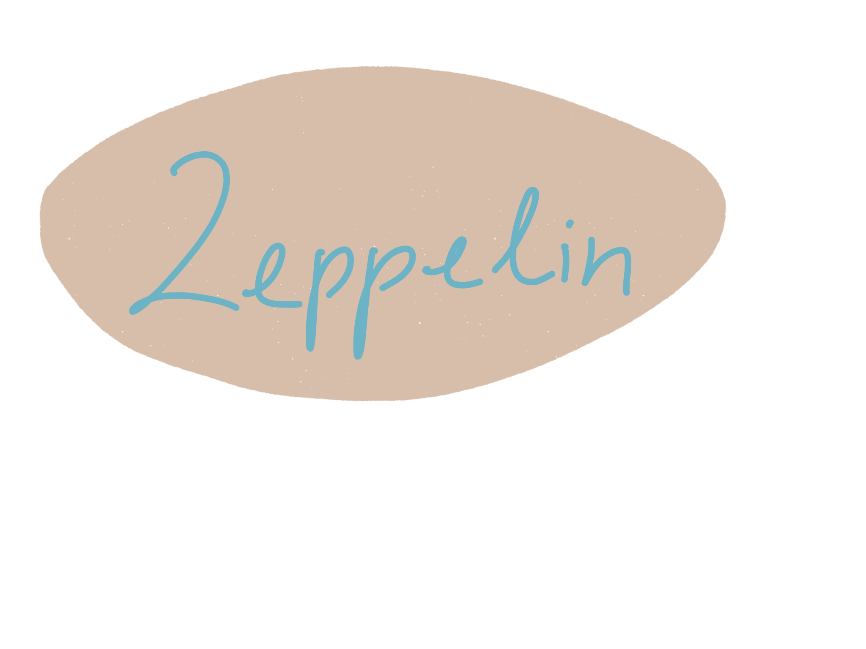



Notebooks
@metricbrew

Slide 11
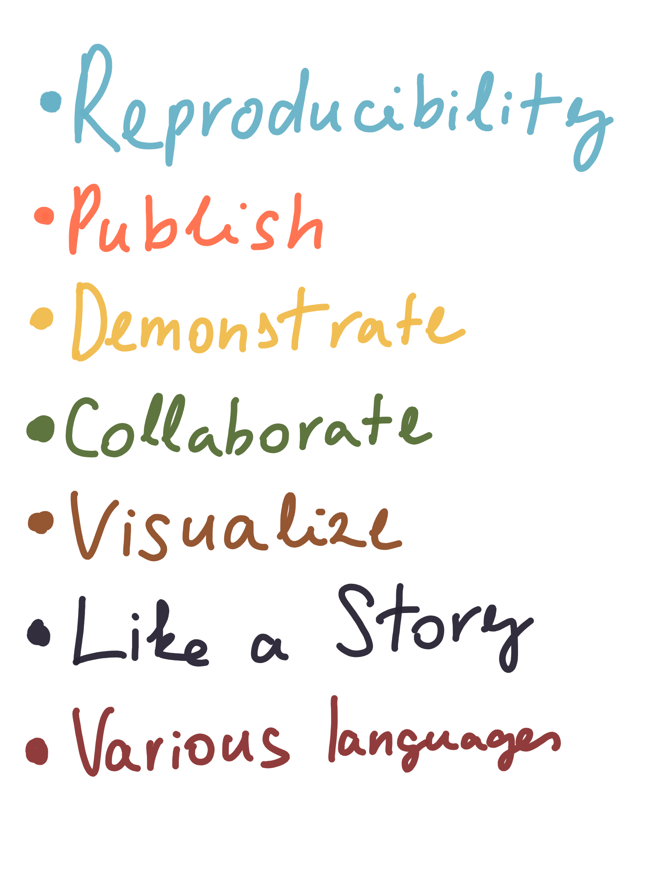
Why we love notebooks
@metricbrew

Slide 12

Apache Zeppelin
@metricbrew

Slide 13
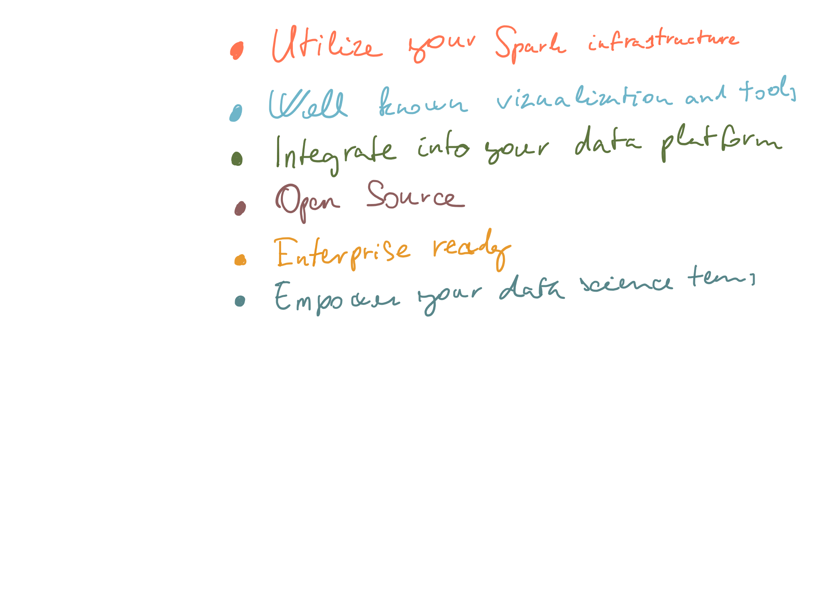
How Zeppelin fits

Slide 14

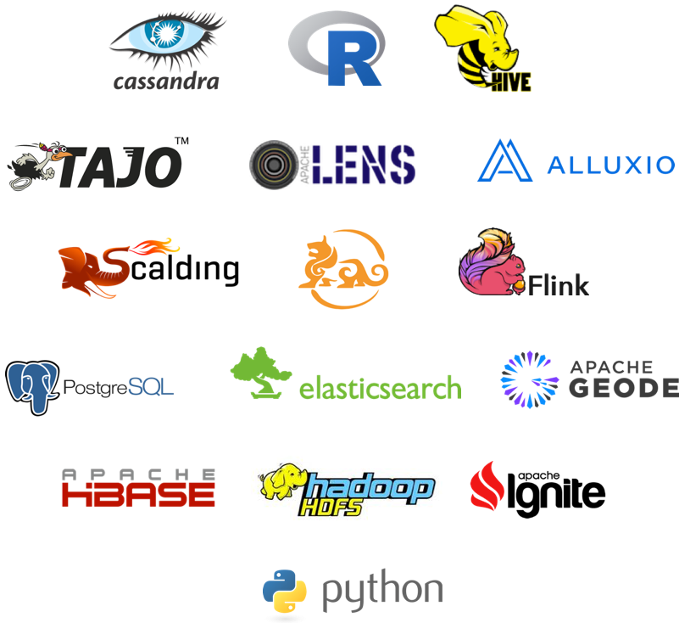
Multi language - Interpreters
@metricbrew
Notes:
JDBC and bash are missing

Slide 15
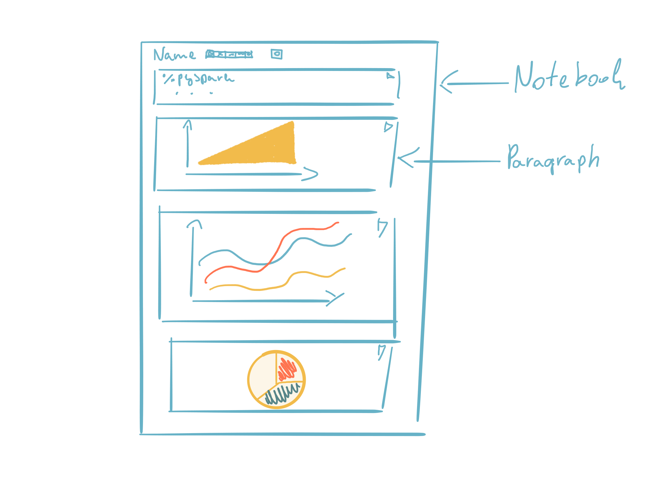
Zeppelin
@metricbrew

Slide 16
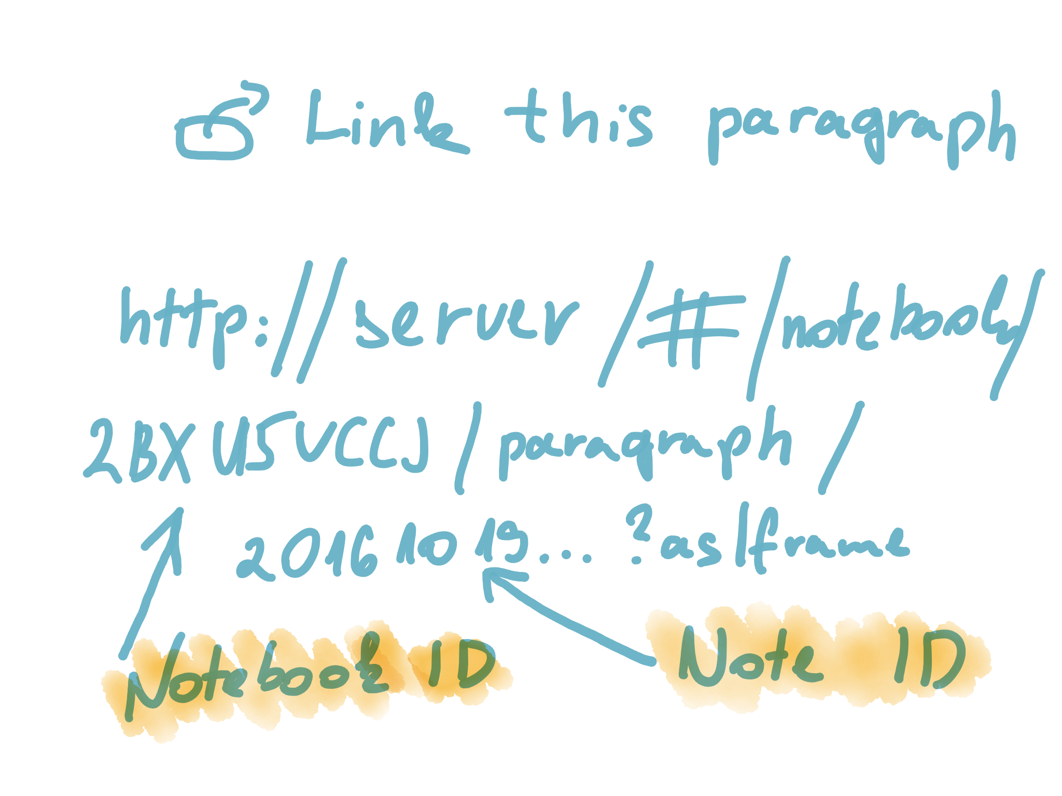
Collaborate
@metricbrew

Slide 17
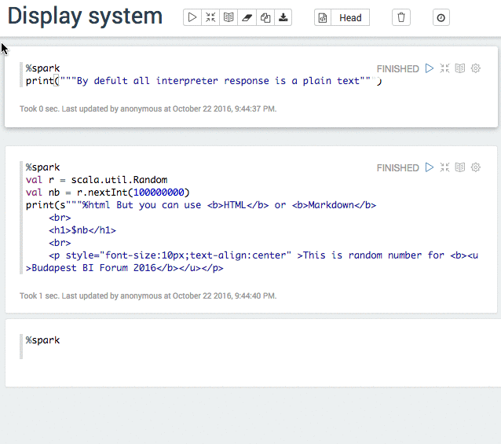
Display system
@metricbrew

Slide 18
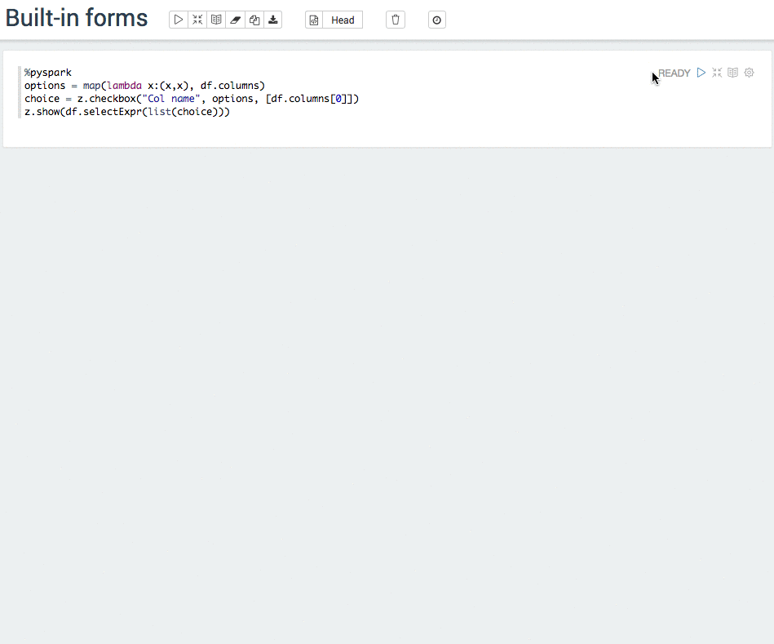
Forms
Built-in
@metricbrew

Slide 19
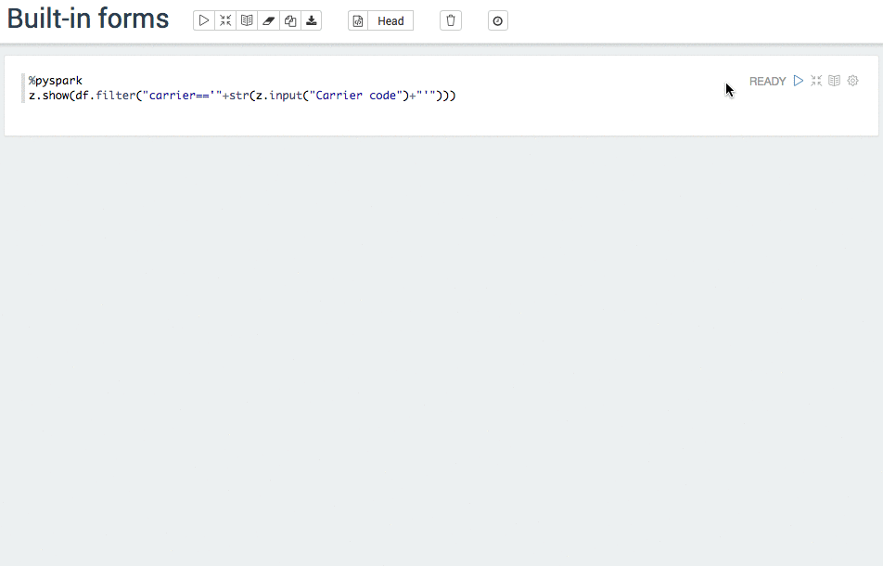
Forms
Built-in
@metricbrew

Slide 20
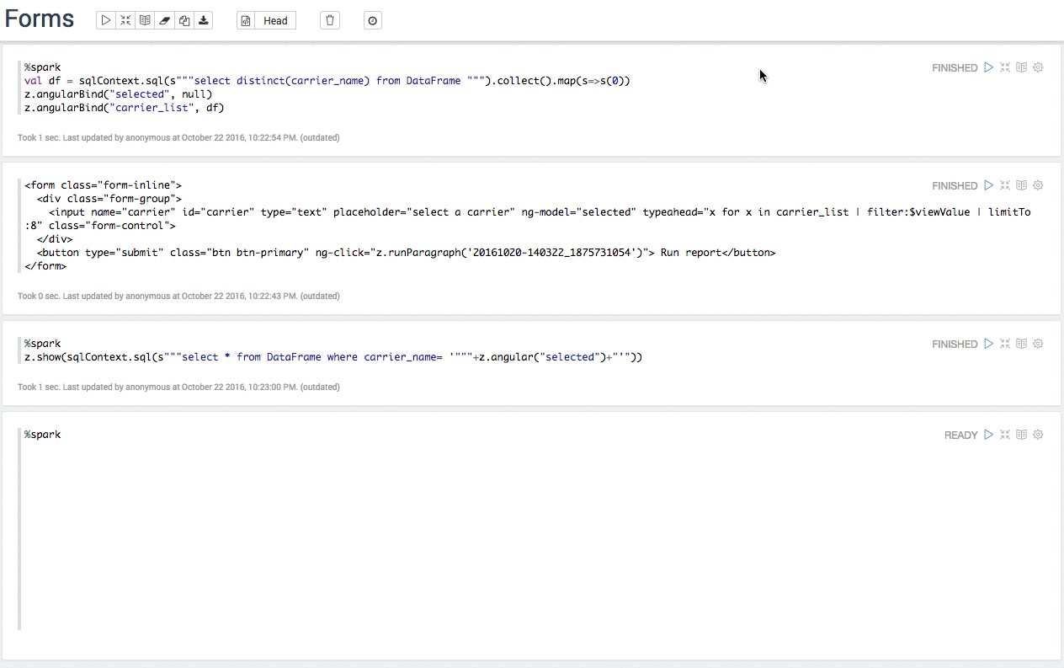
Forms
Angular forms
@metricbrew

Slide 21
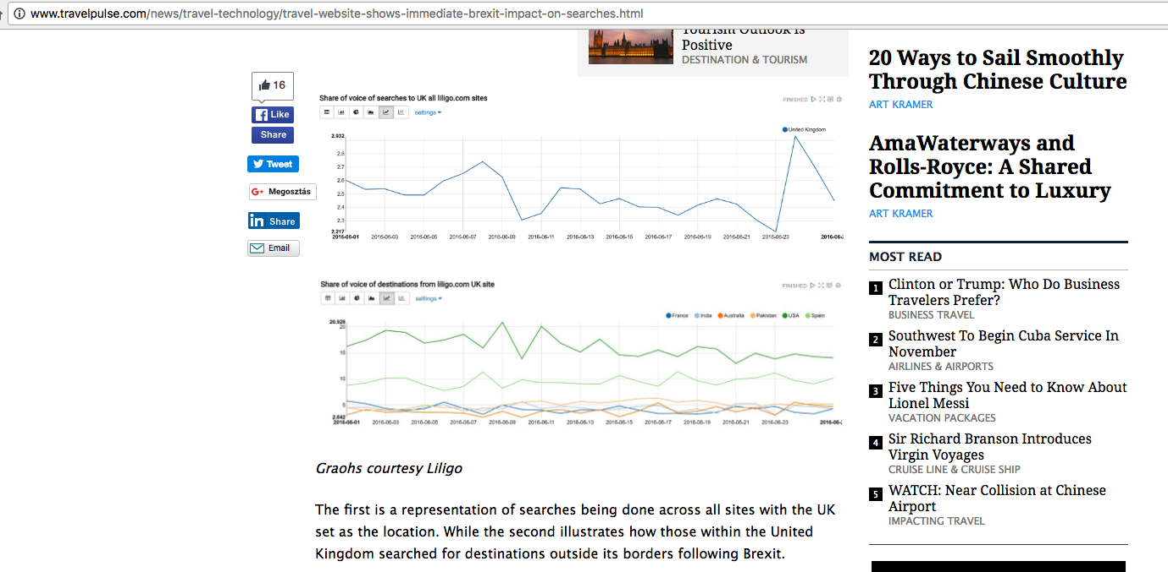
Visualize
@metricbrew

Slide 22
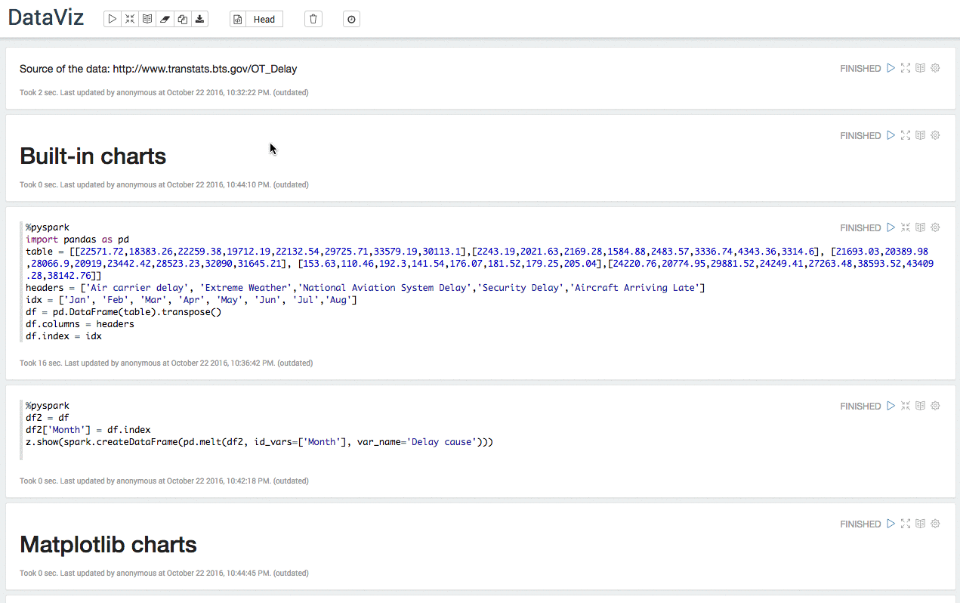
Visualize
Zeppelin charts
@metricbrew
Notes:
Bts = Bureau of Transportation statistics

Slide 23
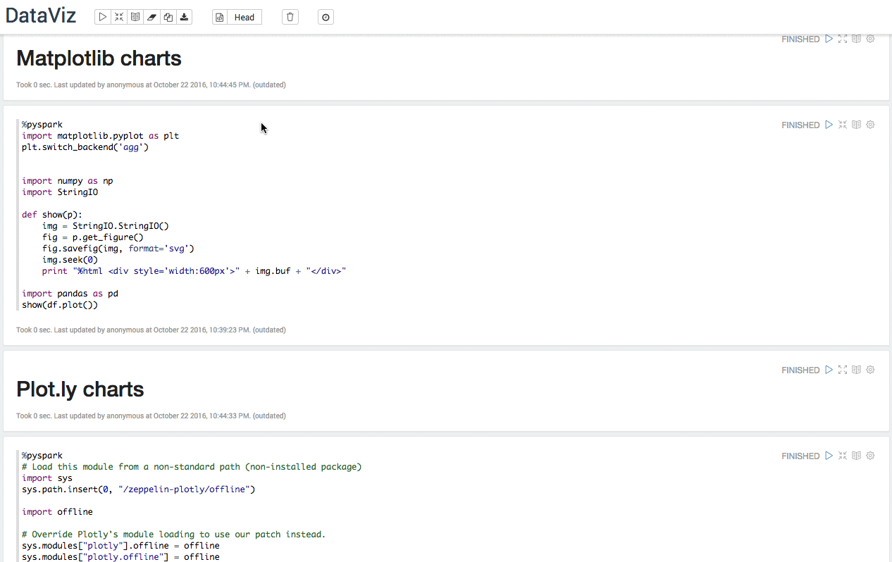
Visualize
Python loves matplotlib
@metricbrew

Slide 24
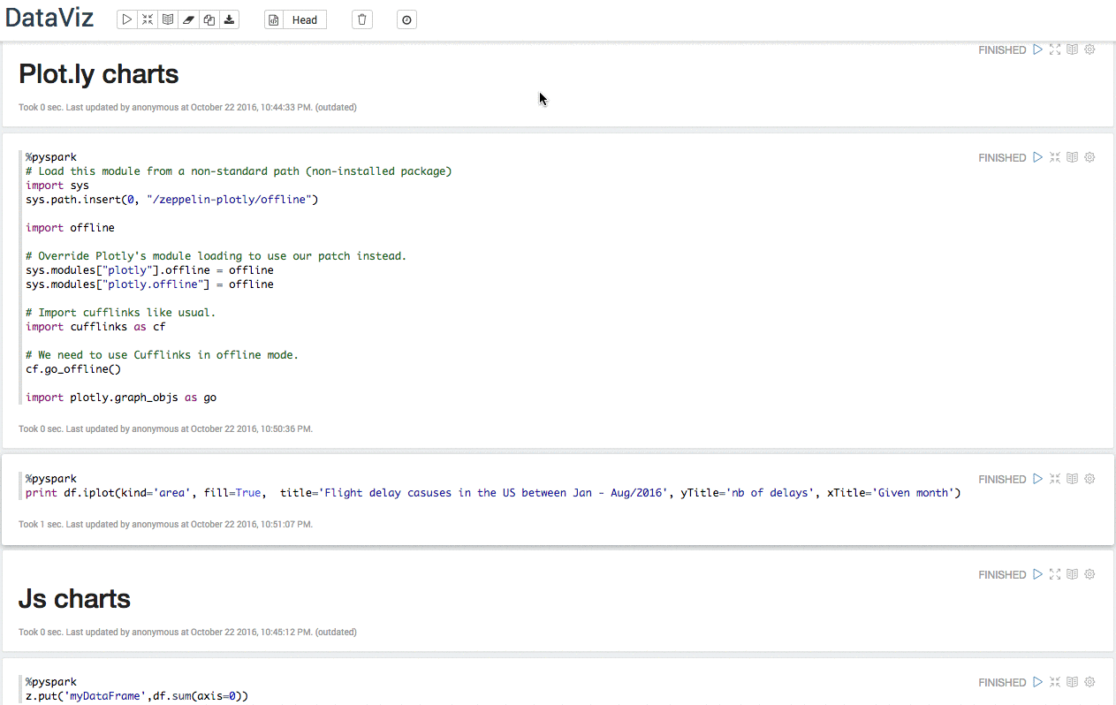
Visualize
Plot.ly
@metricbrew

Slide 25
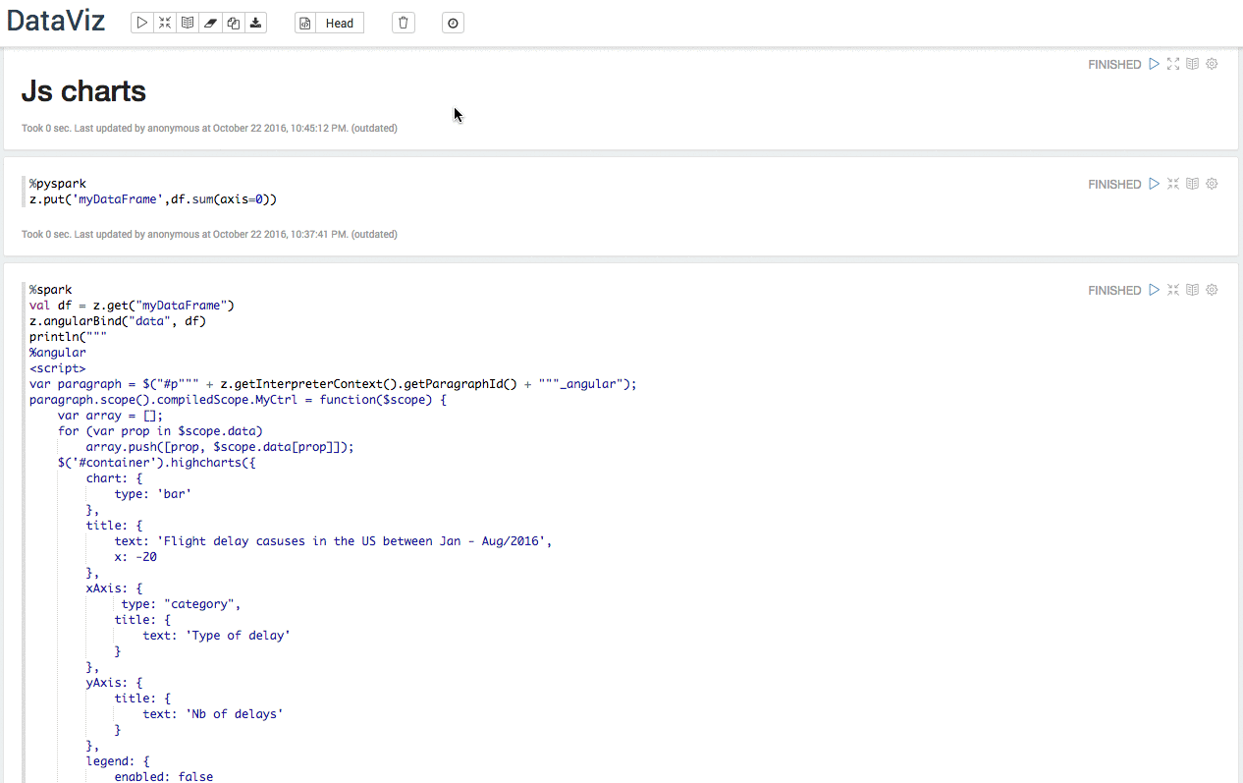
Visualize
JS
@metricbrew

Slide 26

Version control
@metricbrew

Slide 27
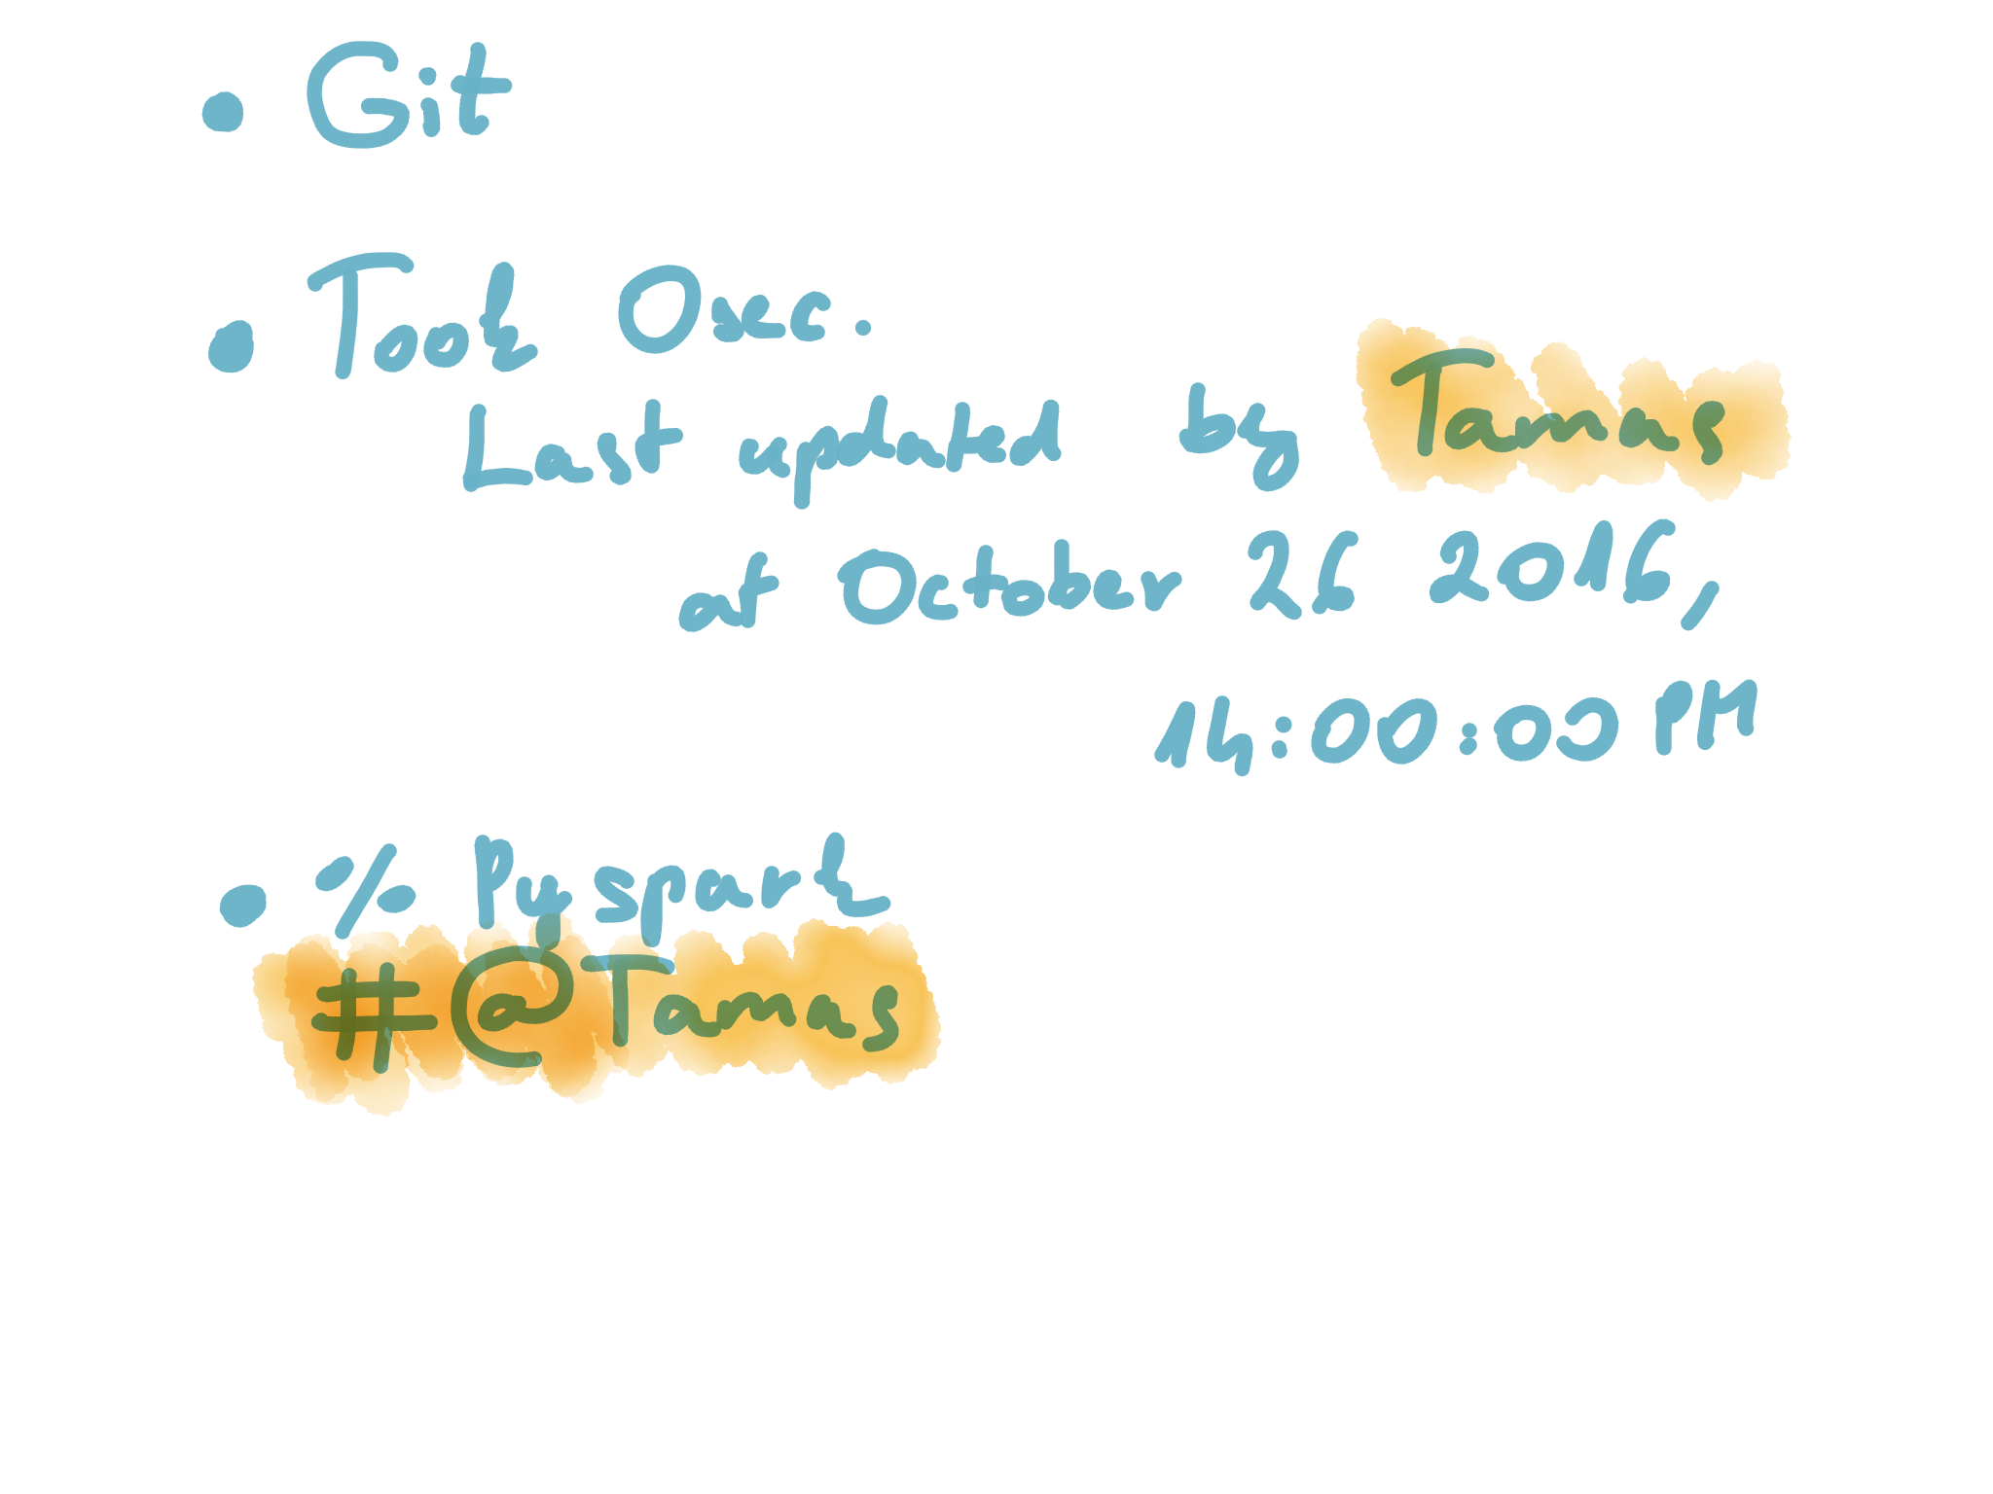
Version control
What we can do
@metricbrew
Notes:
TODO add git

Slide 28

@metricbrew

Slide 29
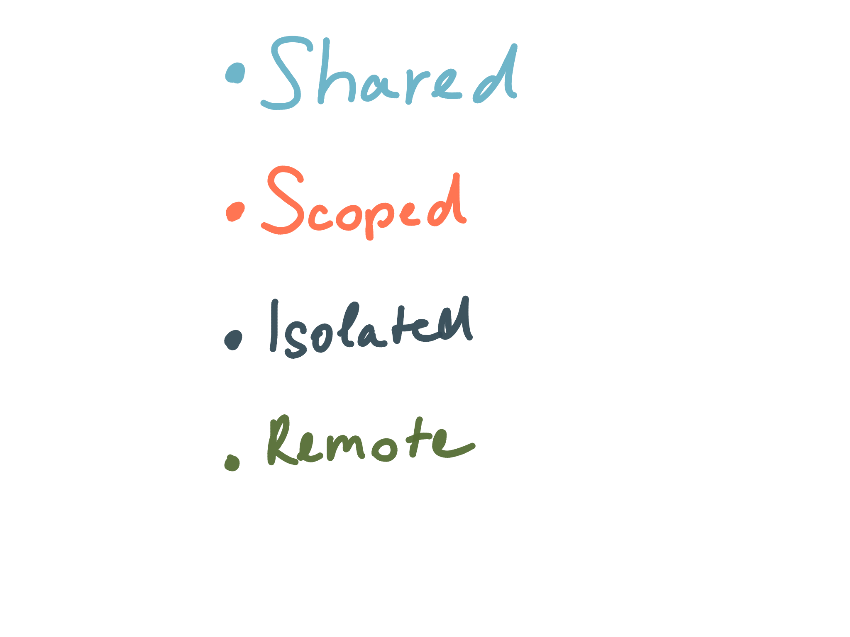
Resources
@metricbrew

Slide 30
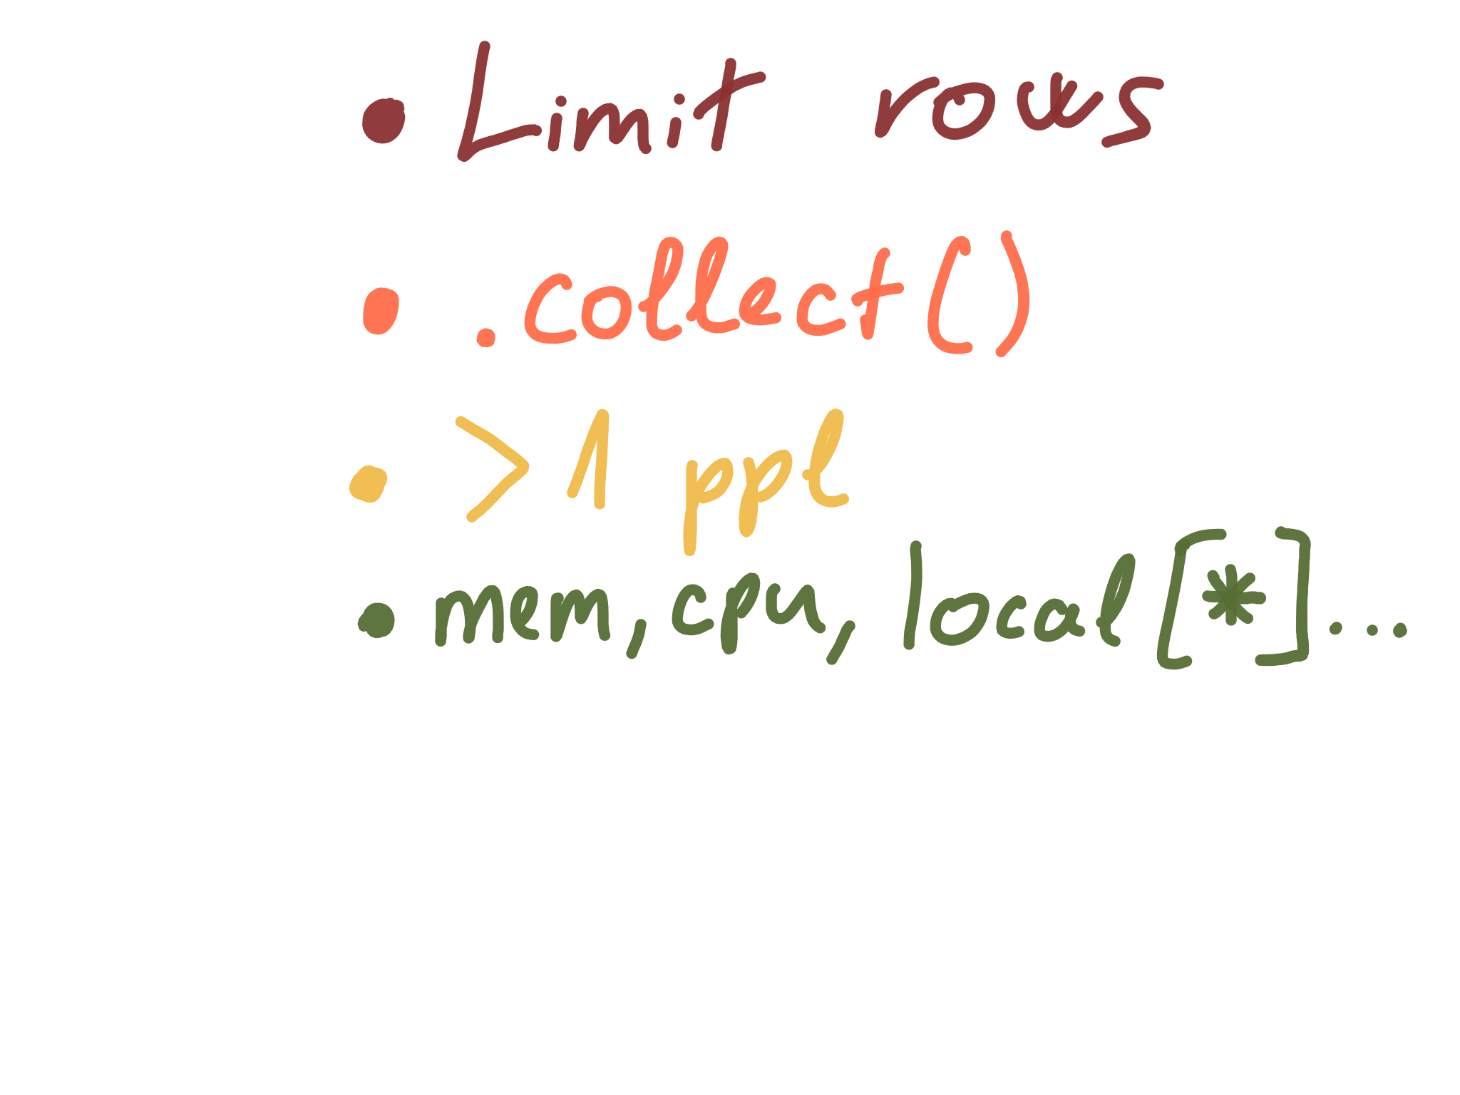
Out of resources
@metricbrew
Notes:
Add local befrora start

Slide 31
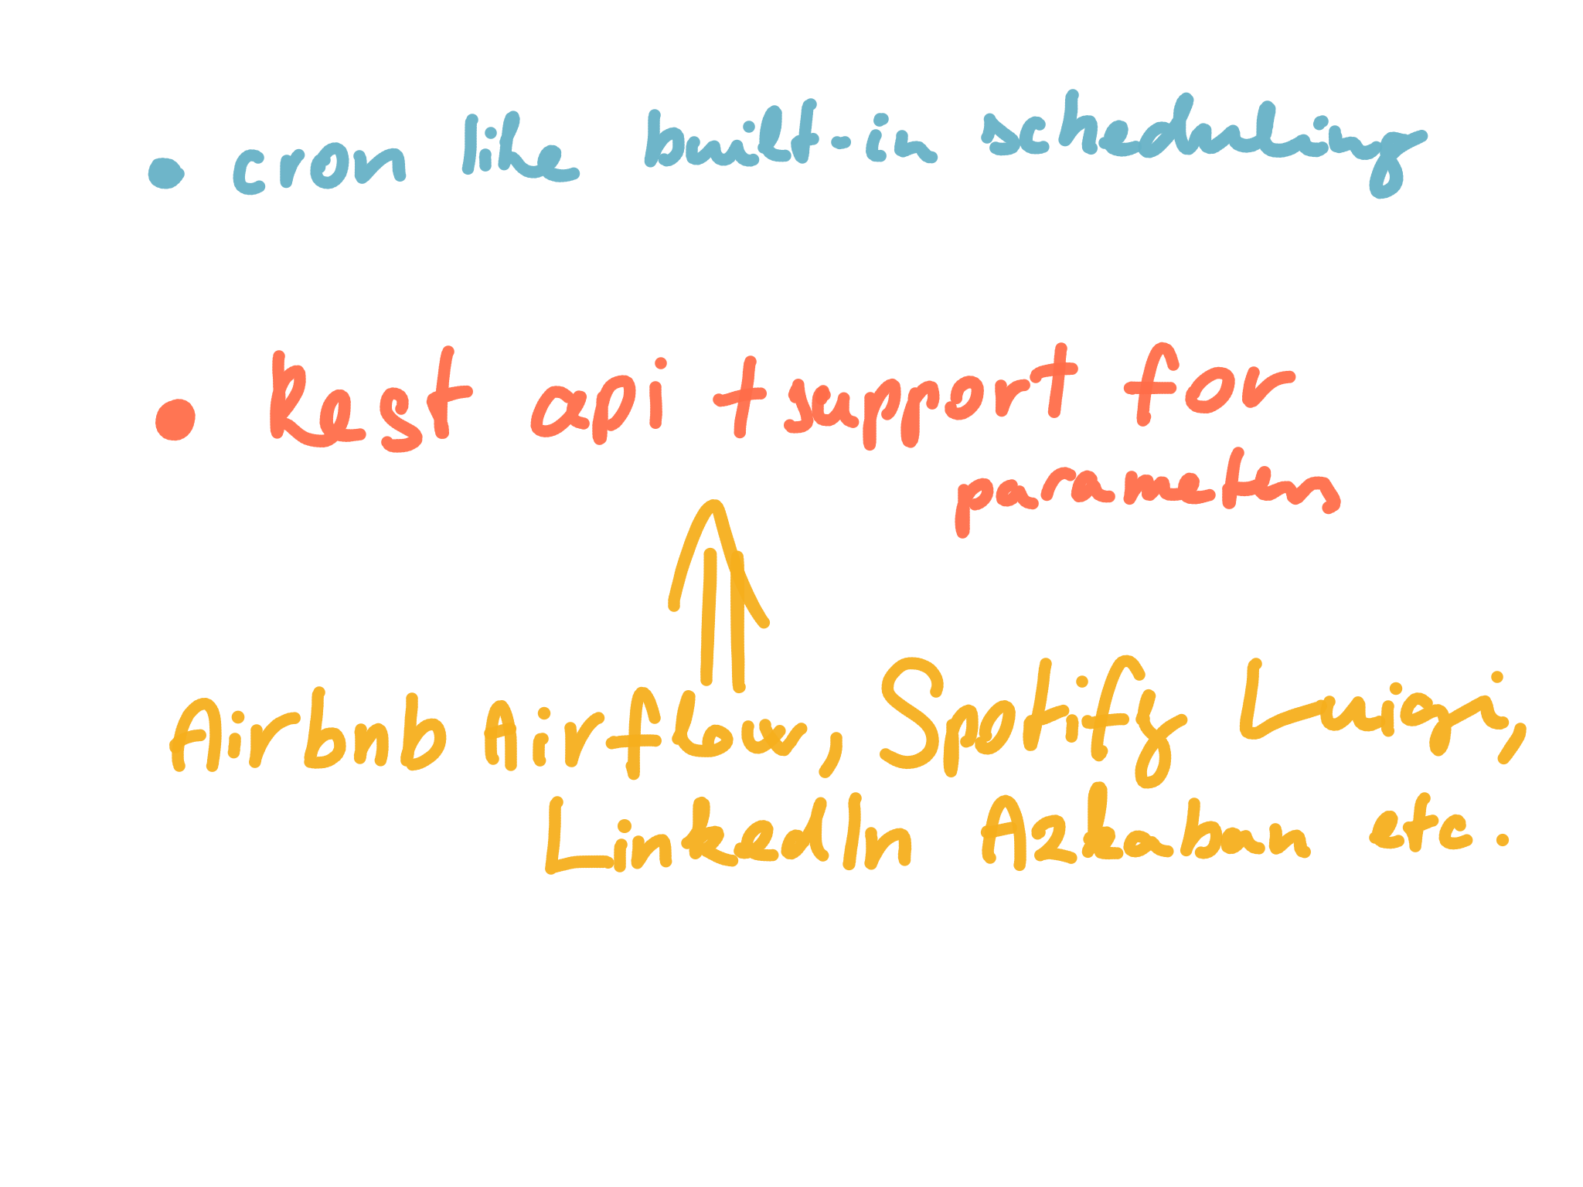
Automate your workflow
@metricbrew

Slide 32
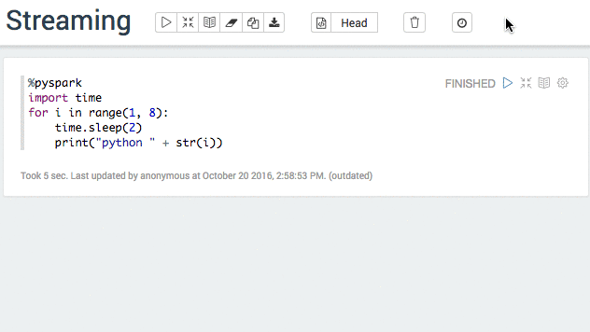
Streaming
@metricbrew

Slide 33

@metricbrew

Slide 34
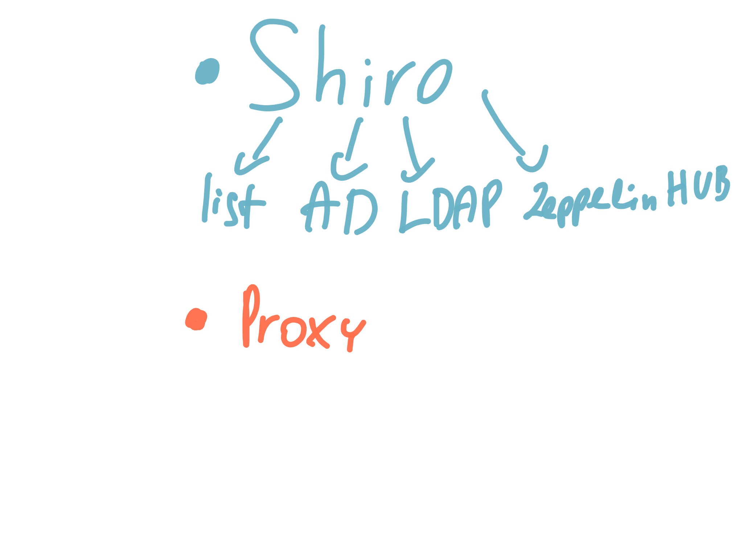
Authentication
@metricbrew

Slide 35
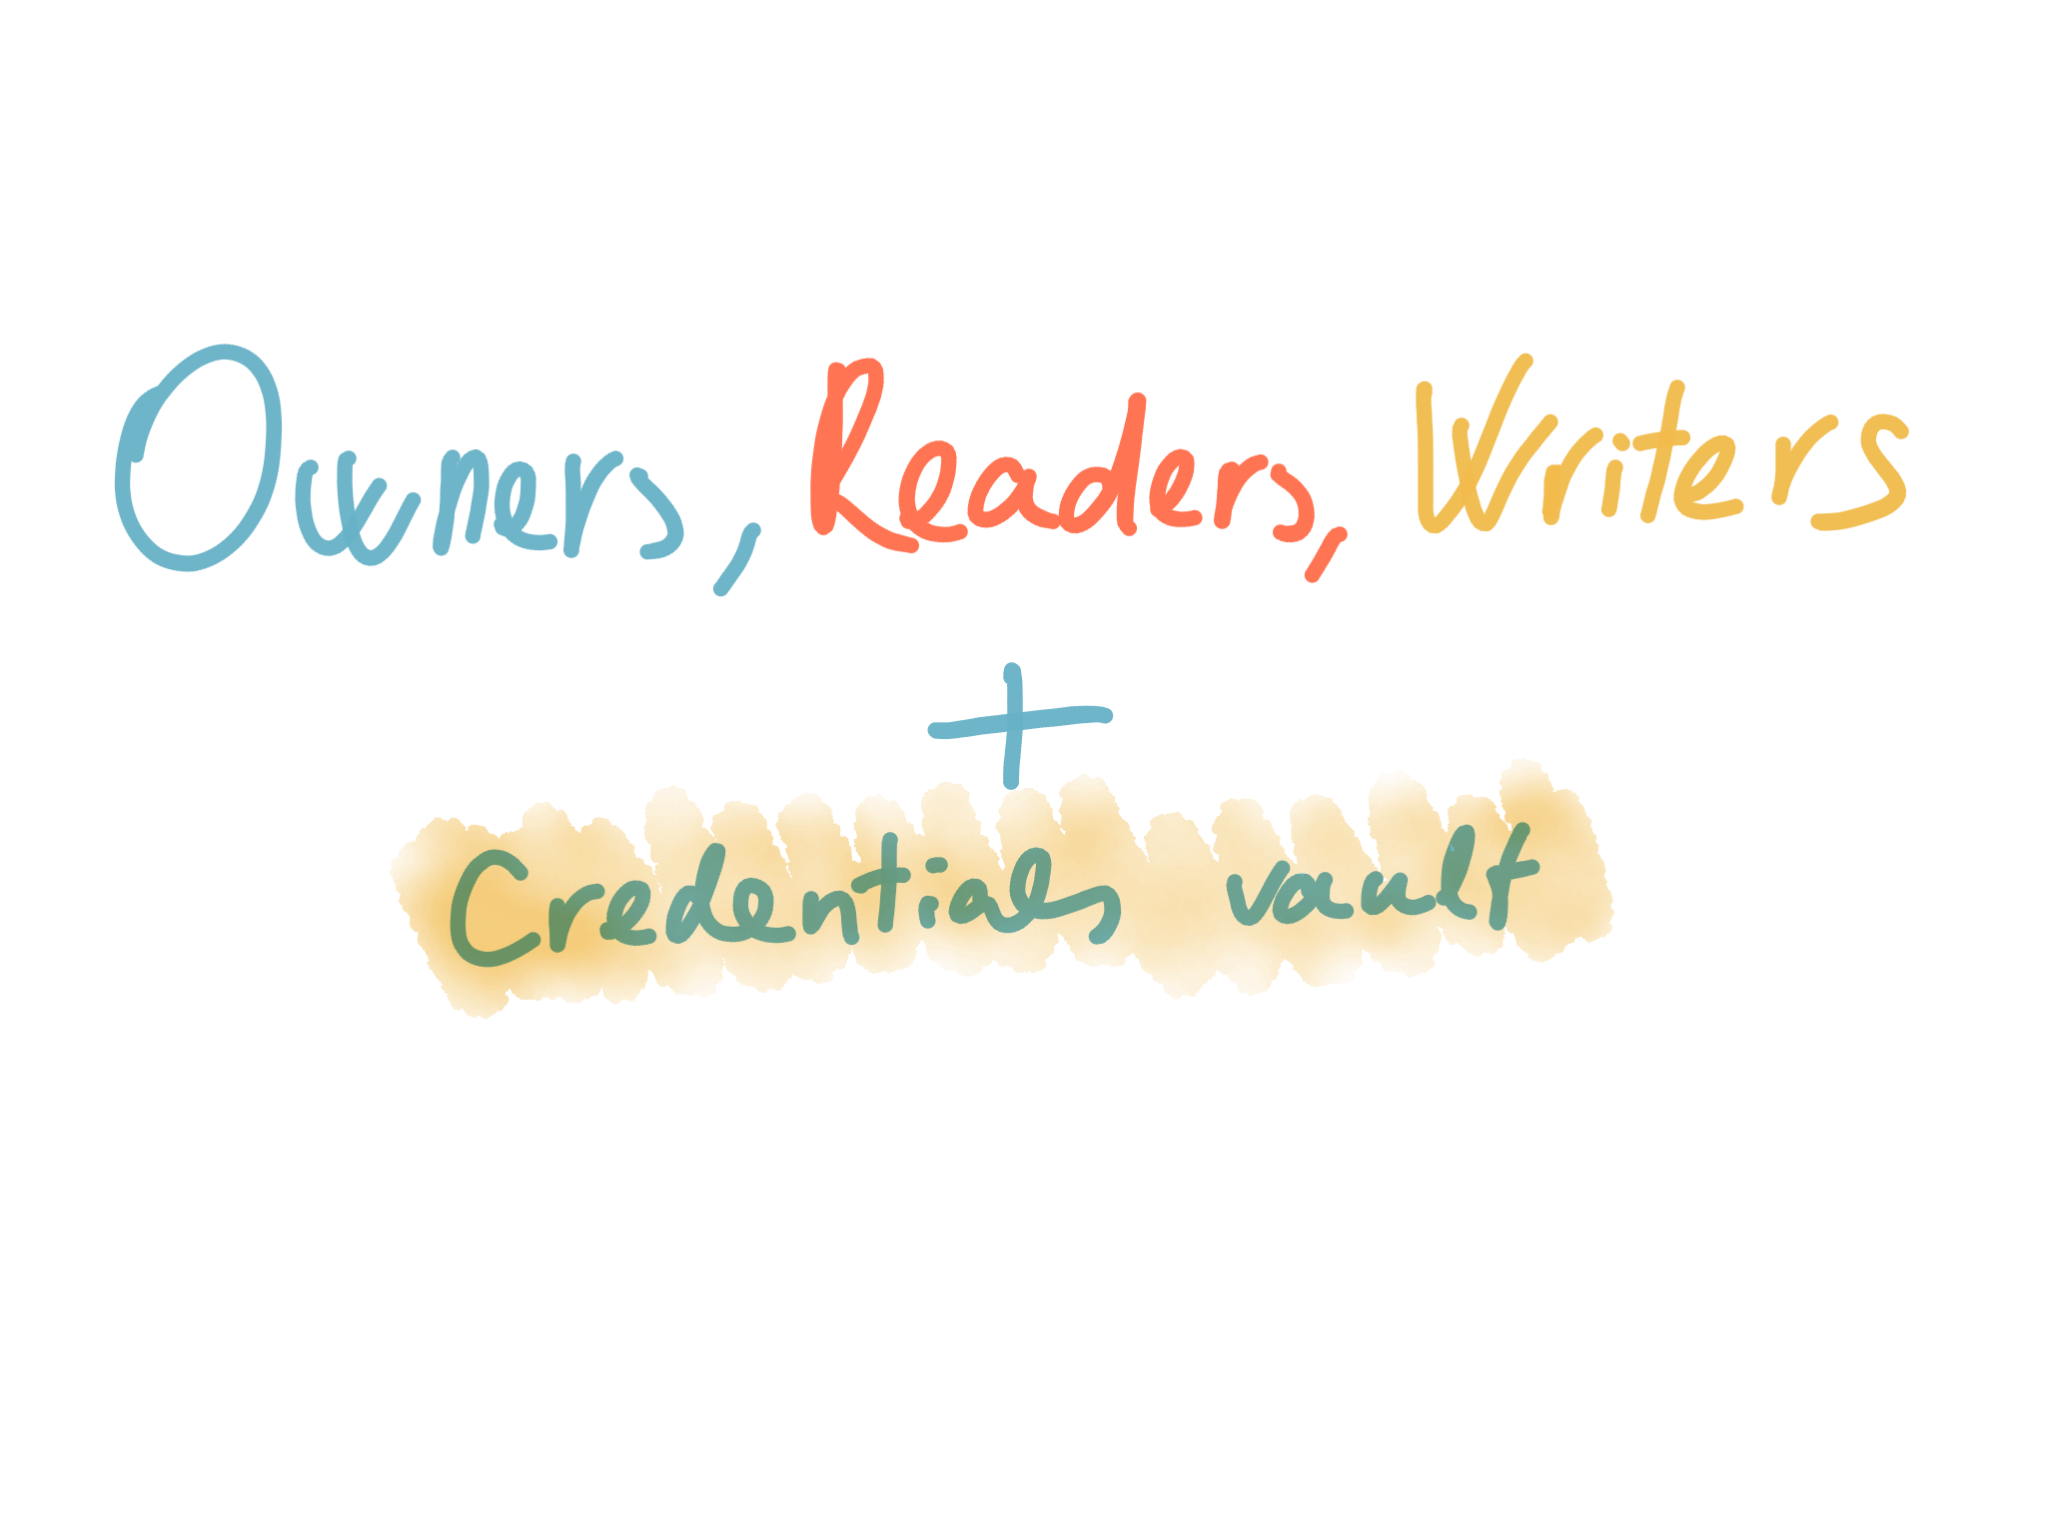
Authorization
@metricbrew

Slide 36
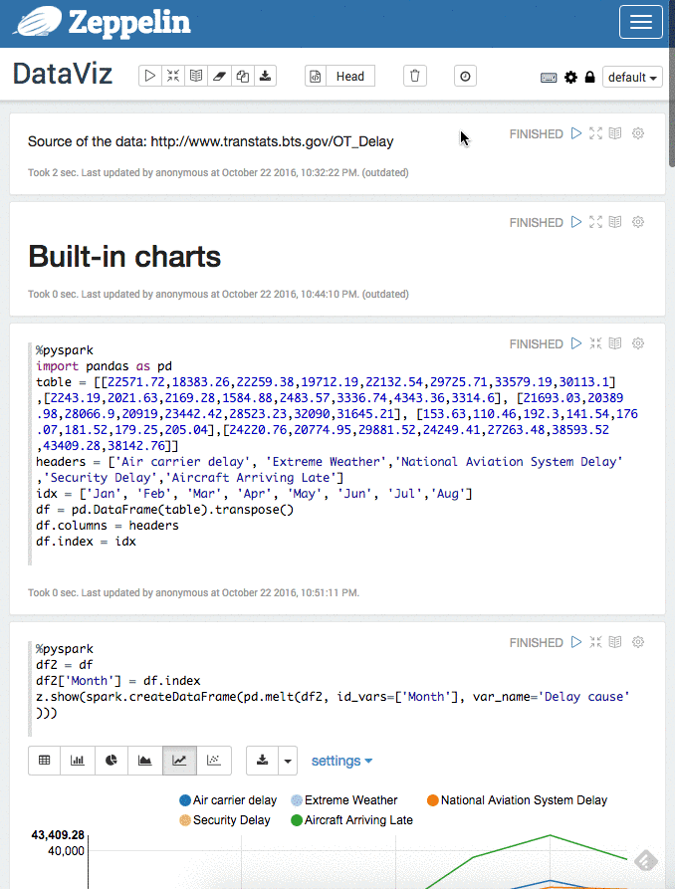
Mobile
@metricbrew

Slide 37
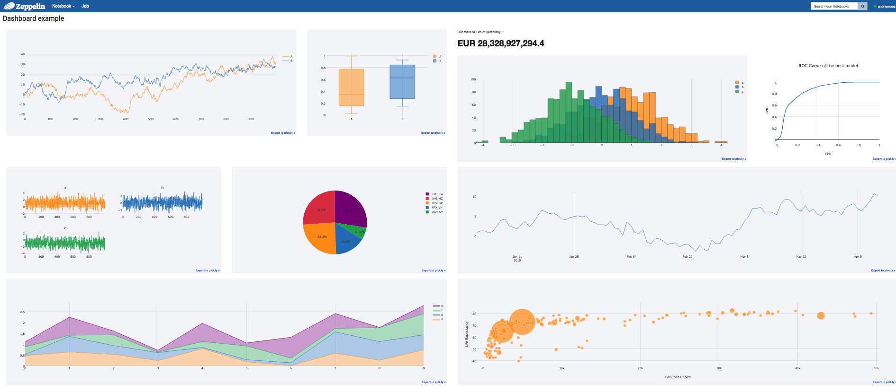
Dashboards
@metricbrew

Slide 38
Thank you!
Tamas Szuromi
tromika@gmail.com
@metricbrew

Slide 39
Links and Sources
https://github.com/tromika/talks/budapestbi2016
http://zeppelin.apache.org/
http://zeppelin.apache.org/community.html
https://github.com/apache/zeppelin
https://github.com/beljun/zeppelin-plotly
https://github.com/tromika/incubator-zeppelin/tree/customjs2
https://hub.docker.com/r/epahomov/docker-zeppelin/

